Slide 1
Social Protection, Nutrition and Resilience
Dr. San San Aye
Deputy Director General, Department of Social Welfare

Slide 2
Resilience
Resilience of individuals: physical, emotional, economic
Resilience of households: coping strategy, food security, livelihoods
Resilience of communities: co-operation, natural resource management
Notes:
Resilience has many dimensions. We can talk about the resilience of individuals, of households, of communities. This can be physical resilience, such as health; emotional resilience, and economic resilience. At household level, resilience can be seen as positive coping strategies when faced with challenges or shocks. It can also be food security, and resilient livelihoods which can adapt to changing economic situations. Resilient communities are those which have good social capital, and which can co-operate to address issues like climate change, disaster risk reduction and management of natural resources

Slide 3
Building future resilience
Improved nutrition and food security during first 1,000 days results in:
Improved health in early childhood
Improved academic performance at school age
Higher wages in adulthood
Notes:
We know from many international studies that improved nutrition in pregnancy and early childhood results in improved health in early childhood, improved academic performance in school age children, and in later life, children who had a good start in life tend to have higher incomes than children who suffered from poor nutrition in the first stage of life.

Slide 4
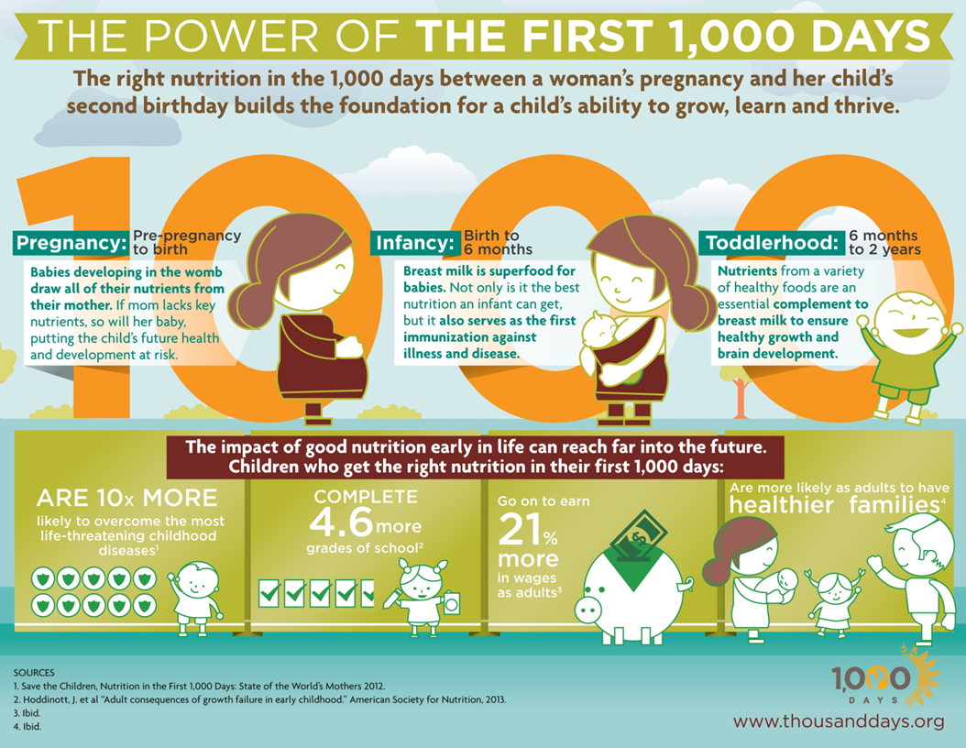
Notes:
This chart shows the benefits: 10x more likely to overcome life-threatening childhood diseases; 4.6 times more likely to complete grades at school, and lather in life, have incomes which are 21% higher.

Slide 5
Food security in households with children
 | % reporting significant shortage
No child | 2%
1-2 children | 2%
1-2 young children (<5) | 3%
> 2 young children | 5%
Notes:
Based on research conducted by SPPRG, together with DRD, we can see that households with children are more likely to reported significant food shortages than households without children. The likelihood of food insecurity is even higher in households with young children, and even higher in households with more than 2 children aged under 5. This shows that young children are at risk of food insecurity.

Slide 6
Resilience in Households with children
 | Loan for consumption | Consumption loan amount as % of annual income
No young child | 14.7% | 60.0%
Young child | 18.5% | 68.0%
>2 young children | 16% | 81%
ALL | 15.6% | 62.0%
Notes:
When we look at research data from rural households, we can also see that households with young children are more likely to get loans for consumption – meaning to buy food in cases of difficulty – which is ‘erosive’ coping strategy. Although this happens in other households without young children, the debt burden which results from this is much higher in households with young children, and even higher in households with more than 2 young children. What we can say is that household resilience in households with young children is lower.

Slide 7
Resilience in Households with young children
 | Low Resilience | Normal or higher resilience
Median annual income | 1,800,000 | 2,000,000
% classified as poor | 26% | 19%
% of income from casual labour | 22% | 15%
% income from non-agricultural source | 64% | 56%
Notes:
However, not all households with young children have low resilience. When we compare households with young children which have low resilience, and households with young children who have normal or higher resilience, the low-resilience households tend to be poorer, have lower incomes, be more reliant on casual labour for their income, and more reliant on non-agricultural livelihoods for their income.

Slide 8
Resilience and Gender, Disability
 | Low Resilience | Food insecurity
Male Headed | 18.8% | 2%
Female Headed | 23% | 3%
No PwD | 19% | 2%
One or more PwD | 22.3% | 4%
Notes:
We can also see that resilience levels are lower in female-headed households, and households with persons with disabilities, and also, food insecurity levels are higher in female-headed and PwD households.

Slide 9
Social Protection and Resilience
Social protection increases resilience by reducing the need for erosive coping (like high-interest loans for consumption)
Social protection increases resilience by reducing food insecurity, improving long-term health and development
Social protection increases resilience by addressing vulnerabilities
Notes:
Here, can give some examples of social protection, such as cash transfers for mother & child, assistance to PwDs

Slide 10
Aspects of social protection
Formal Social Protection: cash transfers, assistance, social security
Non-formal social protection: provided by communities
Notes:
Social protection takes many forms: formal social protection, which can be cash transfers, social assistance, or contributory systems like social security. However, in Myanmar, there is also a strong tradition of community based social protection, which can also have a positive impact on promoting resilience. In 2014, the Myanmar Government approved the National Social Protection Strategic Plan, which includes a range of flagship programmes designed to address vulnerabilities and improve resilience

Slide 11
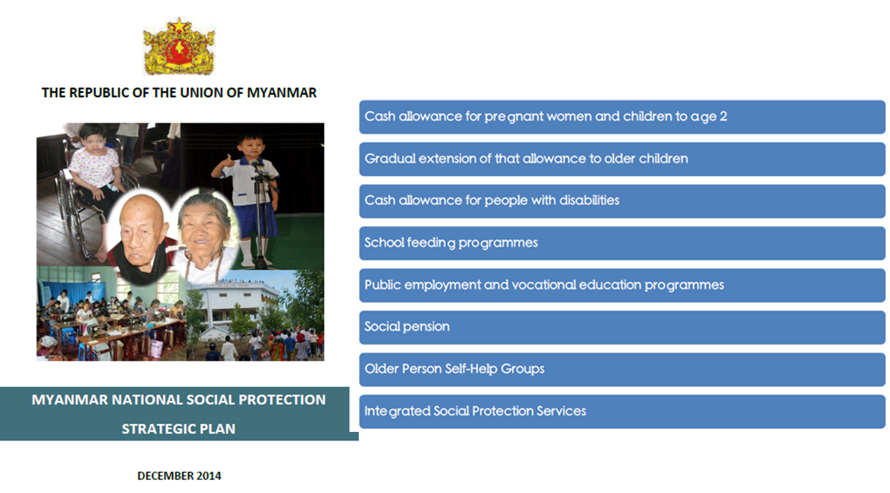

Slide 12
Social Protection for all, and by all
Social protection should be an integral part of wider rural and urban development
Not just the responsibility of one Ministry
Social protection can be a key component to enhance building resilience in other areas such as rural development, urban planning and Disaster Risk Reduction
Notes:
Social protection should be an integral part of wider rural and urban development, not just the responsibility of one Ministry. Social protection can be a key component to enhance building resilience in other areas such as rural development, urban planning and Disaster Risk Reduction. We need to consider more integrated approaches to build resilience at all levels, in order to enable a strong, resilient next generation.

Slide 13
MCCT-Chin: A Tool for Promoting Resilience
Nutrition focused SP for pregnant mothers and children under 2 in Chin state
Objective: Improved nutritional practices and outcomes for mothers and children
First government led state-level Cash Transfer program
First two years with donor funded and then government hand over
Notes:
Here in this slide, let me talk about a nutrition focused social protection scheme for Pregnant Women and children under 2 in Chin state. It is one of the eight flagships of Myanmar National Social Protection Strategic Plan. Basically, it is to improve nutritional practices and outcomes of mothers and children in Chin state. As a long term impact, it can definitely increase the level of resilience of mothers and household and erosive coping strategies through the effective use of cash. This is the first state-level cash transfer program and the first two year will be donor funded and then government will take care of it after that.

Slide 14
MCCT-Chin: A Tool for Promoting Resilience -2
Promote resilience of life through the first 1000 days of life (with immediate impact on accessing health care, medium term impact on nutrition, and long term impact on promoting resilience of life)
Two program components (Cash transfer and Nutritional Behavior Change Communication)
15000 MMK per month per mother bi-monthly basis
Notes:
Definitely, it has multiple dimensional impacts on promoting resilience: as an immediate impact, more capacities on accessing health care, medium impact on nutritional outcome and as a long term impact in promoting resilience of life. If you look at the program, there are two different components of interventions: cash transfer and nutritional behavior change communication. Benefit will be 15000 MMK per month and it will be bi-monthly basis.

Slide 15
Conclusion
Resilience: to cope with change.
Changes are adverse, unexpected, and multi-dimensional nowadays.
Resilience should be built since the early part of life: first thousand days.
Notes:
In conclusion, basically resilience is about coping with change and in the changing environment of this age, changes are adverse, unexpected and it has multi-dimension. So this is very clear, that resilience should be built and promoted since the early part of life that is the first thousand days of life. Lets start with social protection.
Thank you.

